Slide 1
Quality Assurance
Chapter 22

Slide 2

Quality Assurance
Routine periodic evaluation of the Ultrasound system to guarantee optimal image quality
Quality assurance is a medical and legal requirement for every laboratory.
Must be performed periodically and routinely

Slide 3

Why?
We must validate image accuracy and quality.
Quality assurance is a method of testing our machine to make sure that everything is working as it should be and our images are accurate.

Slide 4

Requirements
Assessment of the system’s components
Repairs
Preventative maintenance
Record keeping

Slide 5

Goals
Proper equipment operation
Detection of gradual changes
Minimize downtime
Reduce number of non-diagnostic exams
Reduce number of repeat scans

Slide 6

Methods
Test under known, defined conditions
Constant instrument settings
Use phantom with measurable characteristics
Image in identical environment
A must for every ultrasound lab

Slide 7
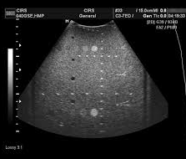
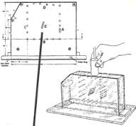
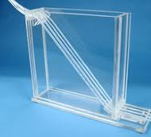
Devices
AIUM 100 mm test object
Tissue equivalent phantom
Doppler phantom
Beam profile/slice thickness phantom

Slide 8
Quality Assurance
Quality assurance or QA is the responsibility of the SONOGRAPHER!!!

Slide 9

AIUM 100mm test object
Fluid filled tank
Contains strategically located metal pins or plastic strings.
Speed of sound in the fluid is the same as that of soft tissue.
Does not have attenuation properties of soft tissue so it cannot evaluate gray scale
Commercially available

Slide 10

Accuracy & Performance
Scanning a test object evaluates the accuracy and performance characteristics of a system.
Placing the transducer on the top, sides, and on the oblique side of the object provides a variety of orientations between the sound beam and the pins.

Slide 11
Electronic caliper accuracy (measurements) are evaluated by comparing the distances between reflections on the display with the actual distances in the test object. ​
Dead zone is evaluated by scanning the pins closest to the top of the object.
Evaluate Dead Zone
Evaluates Lateral Resolution
Evaluates axial
Resolution

Slide 12
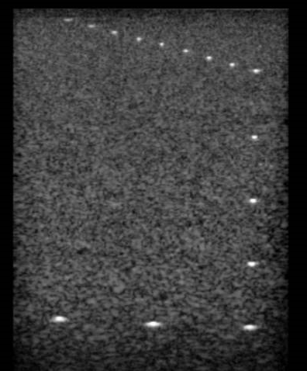
AIUM 100 mm test object

Slide 13

Tissue Equivalent Phantom
Commercially available
Strategically located pins, structures that mimic cysts and solid masses are embedded in the phantom
Sound speed in phantom is equal to speed in soft tissue
Attenuation coefficient similar to that of soft tissue
This phantom is useful for evaluating gray scale

Slide 14
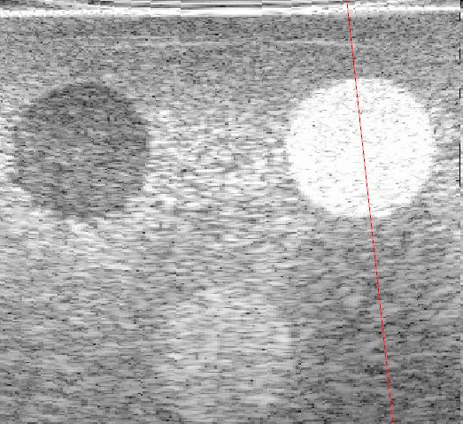
Tissue Equivalent Phantom

Slide 15
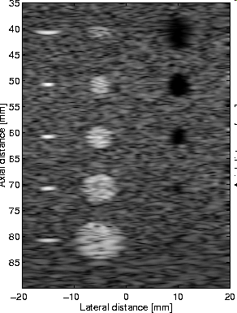
Tissue equivalent phantom

Slide 16
Doppler Phantom
Contains static simulated vessels as well as dynamic simulated vessels at a variety of angles
Pump forces echogenic fluid through “vessels” at known velocities. Constriction is found in one of the vessels as well.
Assesses accuracy of pulsed, continuous wave, and color flow systems
Vibrating sound and moving belt phantoms may also be used to evaluate Doppler systems

Slide 17
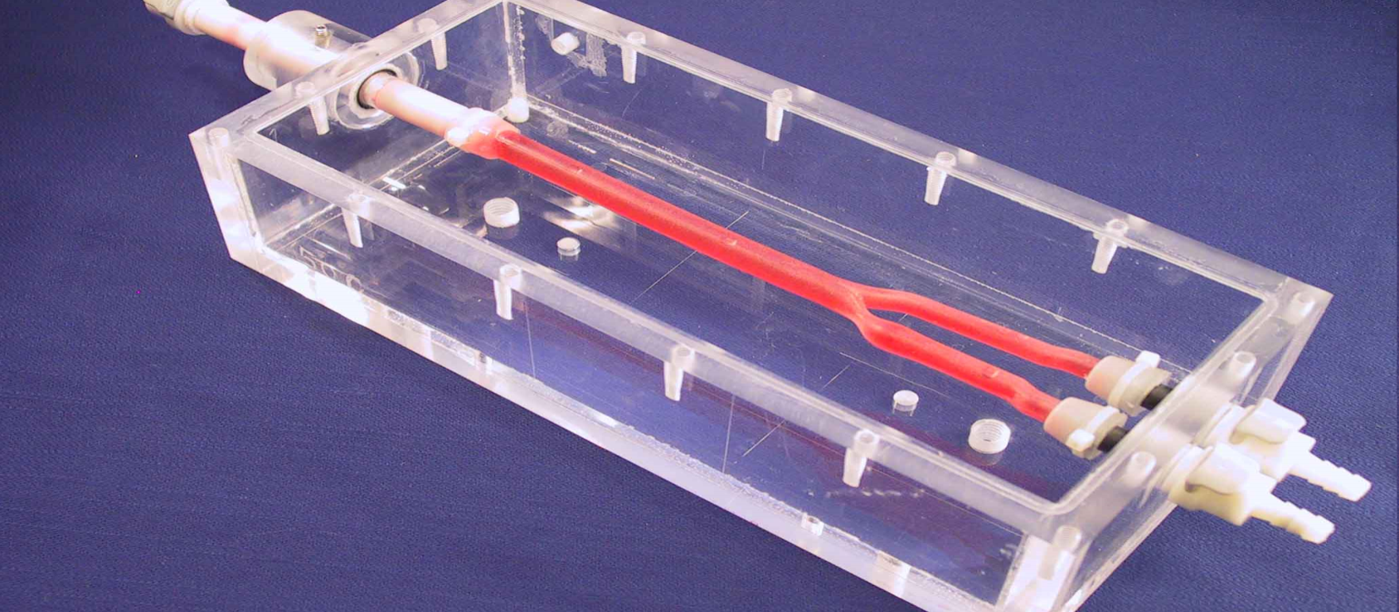
Doppler Phantom

Slide 18

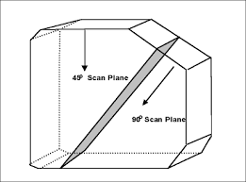
Beam Profiler/Slice Thickness Phantom
Tank with wires imbedded at increasing depths
Used to display the characteristics of ultrasound beams as produced by the transducer
Measures the beam geometry perpendicular to the imaging plane.
Thinner slices improve spatial resolution, so we want to maintain the thinnest slice possible.
If our slice is too thick, objects such as cysts may appear “filled in”

Slide 19
Performance Measurements
Testing the different functions of the machine for accuracy
Several types of performance measurements

Slide 20
Sensitivity
Refers to the ability of a system to display low-level echoes.
It is evaluated in a variety of ways.

Slide 21
Normal Sensitivity
Settings at which all pins, solid masses, and cystic structures in the test phantom are accurately displayed.
Output power, TGC and amplification (gain) are adjusted to establish normal sensitivity.

Slide 22
Minimum Sensitivity
Assessment of the weakest echo signal that is accurately displayed.
Determined by setting TGC flat then increasing system gain from the minimum value to the gain when a deep rod is displayed.
The same rod in the test object should always be tested and settings should not vary from one evaluation to the next.

Slide 23
Maximum Sensitivity
Evaluated with the output power and amplifications set to maximum practical levels.
Tissue phantom is imaged and depth of tissue like texture is determined.
Maximum visualization depth is used to assess sensitivity.

Slide 24
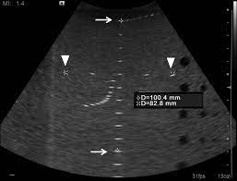
Dead Zone
Region closest to the transducer where images are inaccurate.
Results from the transducer ringing and the time it takes for the system to switch from transmit to receive mode
Assessed with the most shallow series of pins in a test object.
An increasingly deeper dead zone may indicate a cracked crystal, detached backing material, or longer pulse duration.

Slide 25

Range/Registration Accuracy
Describes the systems accuracy in placing reflectors at correct depths located parallel to the sound beam.
If differences appear between ultrasound scan and actual pin locations in a test object the error may be caused by:
System malfunction
Speed of sound in phantom is less than 1540 m/s.

Slide 26
Focal Zone
Sonographer controlled phased array transducers must be carefully evaluated.
Systems with dynamic receive focusing should produce narrow reflections over a wide range of depths.

Slide 27
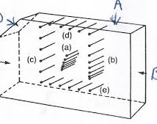
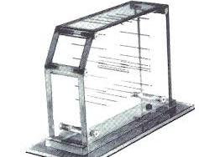
Axial & Lateral Resolution
Axial resolution is evaluated when the pins in the test object are parallel to the sound beam’s main axis.
Lateral resolution is evaluated when the pins in the test object are perpendicular to the sound beam

Slide 28
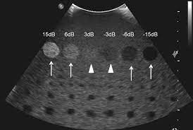
Compensation Operation or Uniformity
Describes the system’s ability to display similar reflectors in the phantom with echoes of equal brightness
With proper TGC, identical reflectors should have the same appearance on the monitor, regardless of the depth

Slide 29
Mock Cysts & Solid Masses
Tissue equivalent phantom is used to evaluate dimension, texture, and fill-in of cysts.
System should accurately display solid structures as hyperechoic and hollow structures as anechoic.

Slide 30
Display, Hardcopy Output, and Gray Scale Dynamic Range
Adjusting the systems output power and amplification should produce changes in the grayscale display
It is important to compare the relationship between the image on the system’s screen with the output of all other display devices such as remote viewing stations (PACS), paper, film etc.
How the image is displayed or sent for someone else to view must be very close to what is seen on your monitor on the machine!

